Slide 1
Bus Terminal Ridership Forecasting & Data Warehouse Design
Database Project 6430
Group 5 – Fall 2025
Deliverables: Forecasting, Key Drivers, Carrier Analysis, Peak Times, Data Warehouse, Power BI Dashboard
  Presented by; Sufiyan Khan, Shah Rabbani, Sujeeth Parikipandla , Sushmitha reddy, Keijounia Thomas and Ranjitha.

Slide 2
Project Overview
This project analyzes and forecasts passenger demand at the bus terminal from 2026–2030.
The goal is to support planning for temporary staging facilities during the reconstruction phase.
The project combines Python analytics, Power BI visualizations, SQL modeling, and a SSIS data warehouse.
Results guide operational decisions and long-term capacity management.

Slide 3
Introduction & Objectives
Introduction
This project focuses on forecasting bus terminal passenger demand for the years 2026–2030, a period during which the Port Authority will operate temporary staging facilities during major reconstruction.
The study integrates Python forecasting, Power BI analytics, Snowflake SQL, and a custom data warehouse to deliver a complete operational planning toolkit.
Insights from this project support capacity planning, scheduling, and long-term infrastructure decisions.
Objectives
Forecast total passengers from 2026–2030 to estimate future facility usage.
Identify the most important factors driving ridership.
Produce individual carrier-level forecasts for targeted operational planning.
Determine the busiest weeks, months, and years during the forecast window.
Compare current ridership against the pre-pandemic baseline year 2019.
Build a data warehouse optimized for analytics and forecasting.
Create a GitHub project portfolio with all deliverables, dashboards, and documentation.

Slide 4
Dataset Description
Data includes daily ridership, carriers, service types, departures, and external factors.
Sources include Snowflake tables and cleaned Excel data.
Key fields used: FULL_DATE, CARRIER, PASSENGERS, SERVICE_TYPE, HOLIDAY_FLAG, FUEL_PRICE, and more.
Prepared through Python preprocessing and SQL transformations.

Slide 5
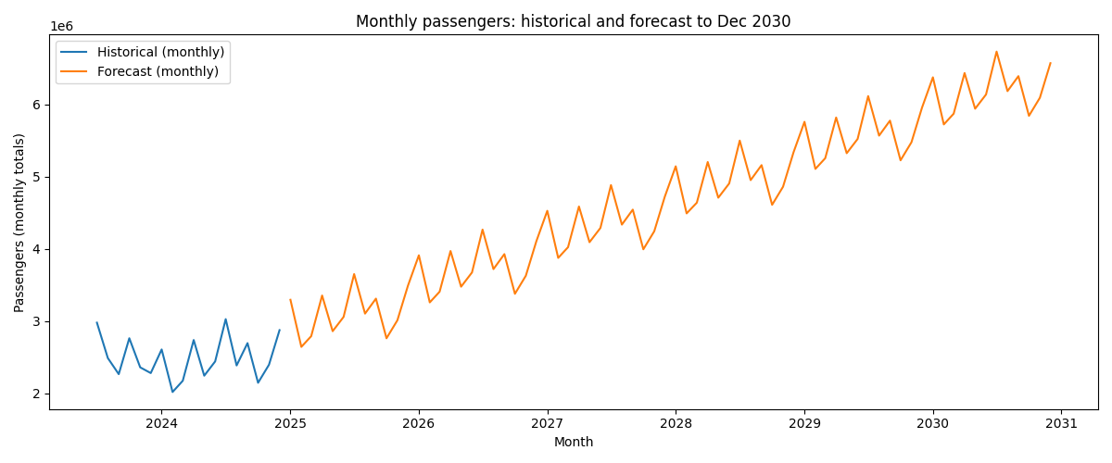
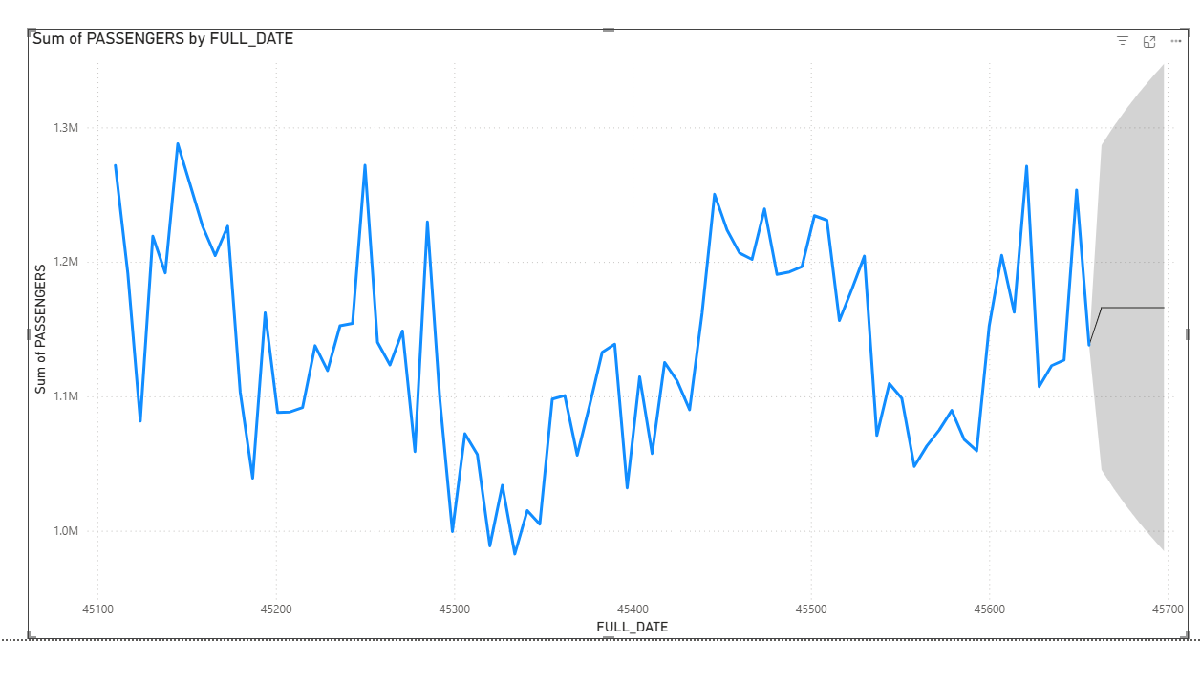
Forecasting Methodology
Python used to build the forecasting model (Prophet/ARIMA).
Training data includes multi-year historical passenger totals.
Forecast generated for 2026–2030 with upper/lower confidence intervals.
Power BI used for 6-month short-term forecasting visualization.

Slide 6
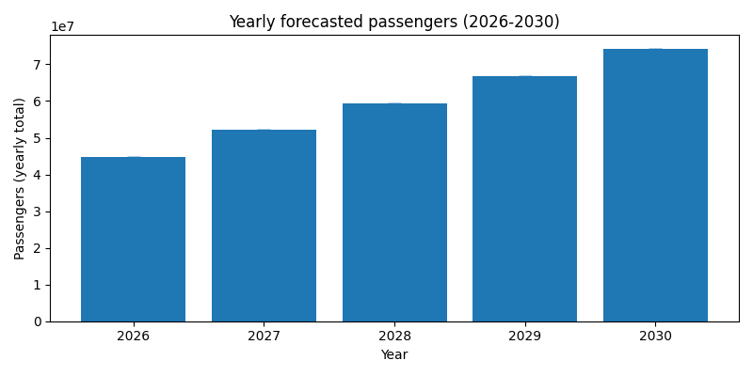
Total Passenger Forecast (2026–2030)
Results show steady growth from ~44.7M in 2026 to ~74.2M in 2030.
Growth reflects recovery from pandemic effects and rising demand.
Upper-bound confidence intervals indicate potential for even higher ridership.

Slide 7
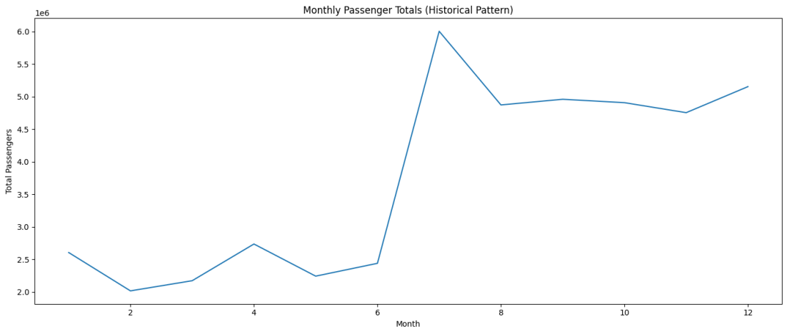
Key Predictors of Ridership
Python feature-importance modeling (Random Forest / Linear Regression).
Most influential variables include:
Service Type (express vs. local)
Holiday Flags
Fuel Prices
Carrier Patterns
Day/Month/Season effects
Findings help optimize scheduling and staffing.

Slide 8
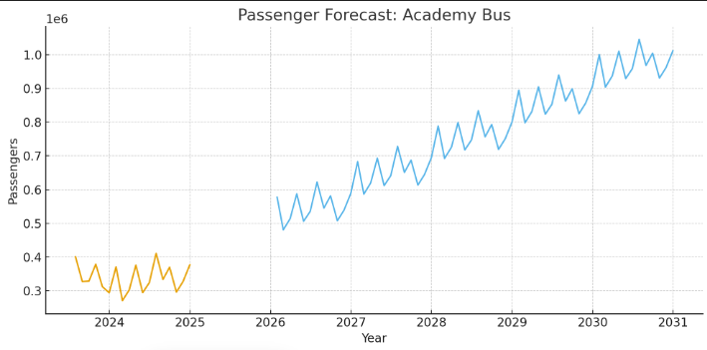
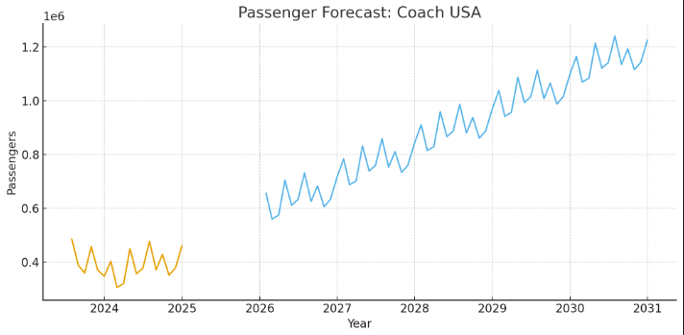
Carrier-Level Forecasting
Python models applied separately for each carrier.
Clear variation in demand across carriers, influenced by route patterns and service frequency.
Growing carriers indicate higher future demand for gate/bay allocations.

Slide 9
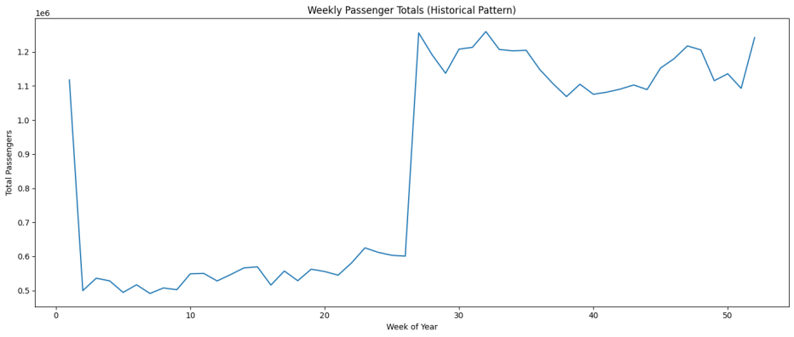
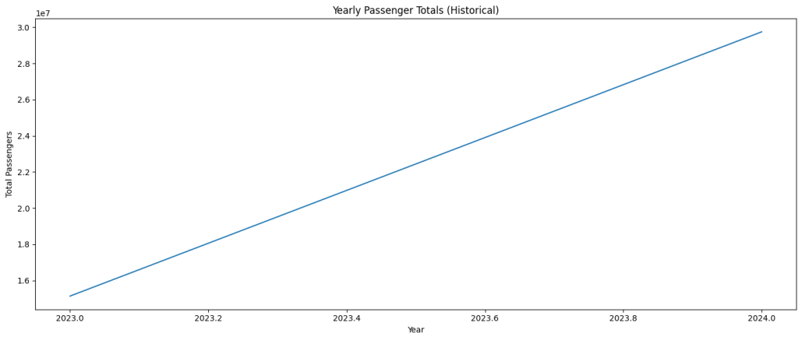
Busiest Periods (Week/Month/Year)
Weekly patterns show consistent spikes around commuting days and holidays.
Monthly and yearly analysis reveals strong seasonal peaks in summer and winter travel periods.
Forecasted busiest times between 2026–2030 help design staging capacity requirements.

Slide 10
Comparison to 2019 Baseline
2019 used as the last stable pre-COVID benchmark.
Current ridership has returned to or surpassed 2019 levels.
Upward trend confirms a full recovery and strong future demand growth.

Slide 11
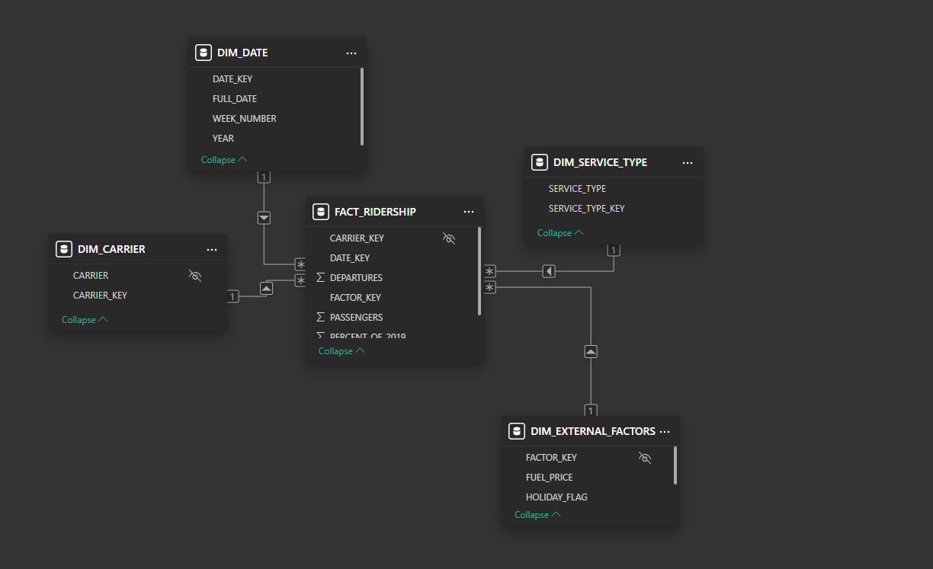
Data Warehouse Design
Built using a Star Schema to support fast analytics.
Tables include:
Fact_Ridership
Dim_Date, Dim_Carrier, Dim_Service_Type, Dim_External_Factors
Optimized for Power BI models and future machine learning integration.

Slide 12
GitHub Portfolio
GitHub repository includes:
Final project report
Power BI dashboard (embedded data)
Python forecasting scripts
SQL code and warehouse schema
“Project Resources” document

Slide 13
Conclusion
This project delivered a complete forecasting and analytics framework for planning bus terminal operations during the 2026–2030 reconstruction period.
Forecast models show steady ridership growth, emphasizing the need for expanded staging capacity and strategic scheduling.
Carrier-level analysis and peak-time projections provide actionable insights for managing gates, staffing, and passenger flow.
The custom data warehouse enables fast, scalable analytics and supports future reporting and machine learning tasks.
With the GitHub portfolio, Power BI dashboard, and final report, the project offers a fully documented, end-to-end solution for data-driven decision making.

Slide 14
References
Arumsari, S. S., & Aamer, A. (2022). Design and application of data analytics in an internet-of-things enabled warehouse. Journal of Science and Technology Policy Management, 13(2), 485-504.
El-Taweel, N. A., Farag, H. E., Barai, G., Zeineldin, H., Al-Durra, A., & El-Saadany, E. F. (2021). A systematic approach for design and analysis of electrified public bus transit fleets. IEEE Systems Journal, 16(2), 2989-3000.
Lavanya, A., Gaurav, L., Sindhuja, S., Seam, H., Joydeep, M., Uppalapati, V., ... & SD, V. S. (2023). Assessing the performance of Python data visualization libraries: a review. Int. J. Comput. Eng. Res. Trends, 10(1), 28-39.

